Slide 1
FDI Visualization
File created on: 3/31/2024 1:40:17 PM

Slide 2
KEY PERFORMING INDICATORS
Total FDI inflows: This KPI measures the total amount of foreign direct investment received in India over the 17-year period covered in the dataset. It can help provide a high-level overview of the overall trend of FDI in India.
FDI inflows by sector: This KPI measures the amount of FDI received in each sector of the Indian economy over the 17-year period. It can help identify which sectors are attracting the most FDI, as well as potential areas of growth or opportunity.
FDI inflows by financial year: This KPI measures the amount of FDI received in each financial year over the 17-year period. It can help identify trends in FDI inflows over time, as well as any fluctuations or changes in the level of investment.
Average FDI inflows: This KPI measures the average amount of FDI received per year over the 17-year period. It can help provide a more stable and consistent measure of FDI trends over time.
FDI inflows by country of origin: This KPI measures the amount of FDI received in India from each country of origin over the 17-year period. It can help identify which countries are the largest sources of FDI in India, as well as potential opportunities for further investment.
Year-over-year growth rate: This KPI measures the percentage change in FDI inflows from one financial year to the next. It can help identify any trends or patterns in the growth of FDI in India, as well as any potential areas of concern or opportunity.
Top investors: This KPI measures the top investors in India over the 17-year period, based on the amount of FDI received. It can help identify the most significant contributors to FDI in India, as well as potential areas of focus for future investment.

Slide 3
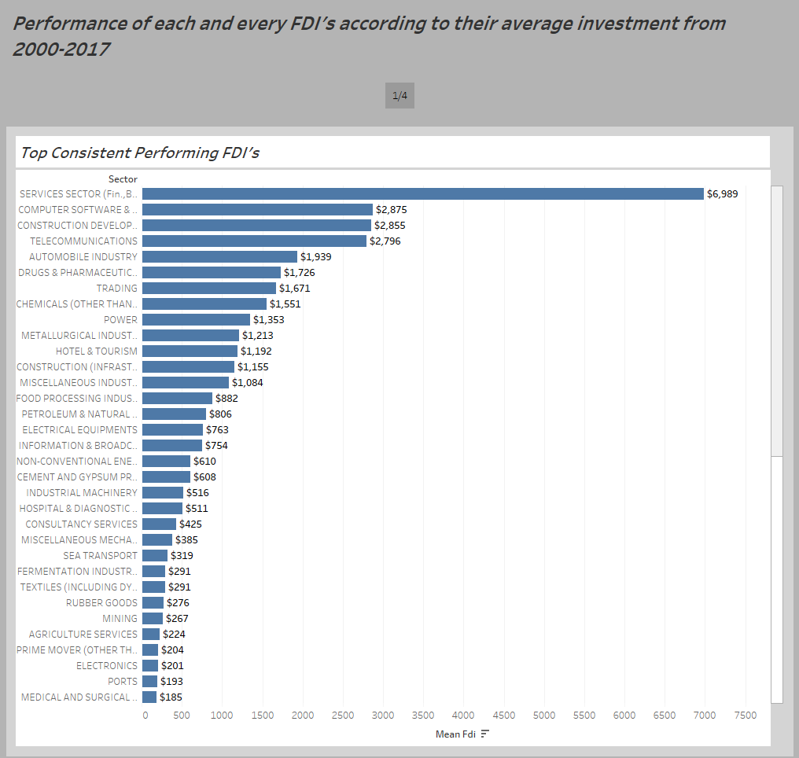

Slide 4
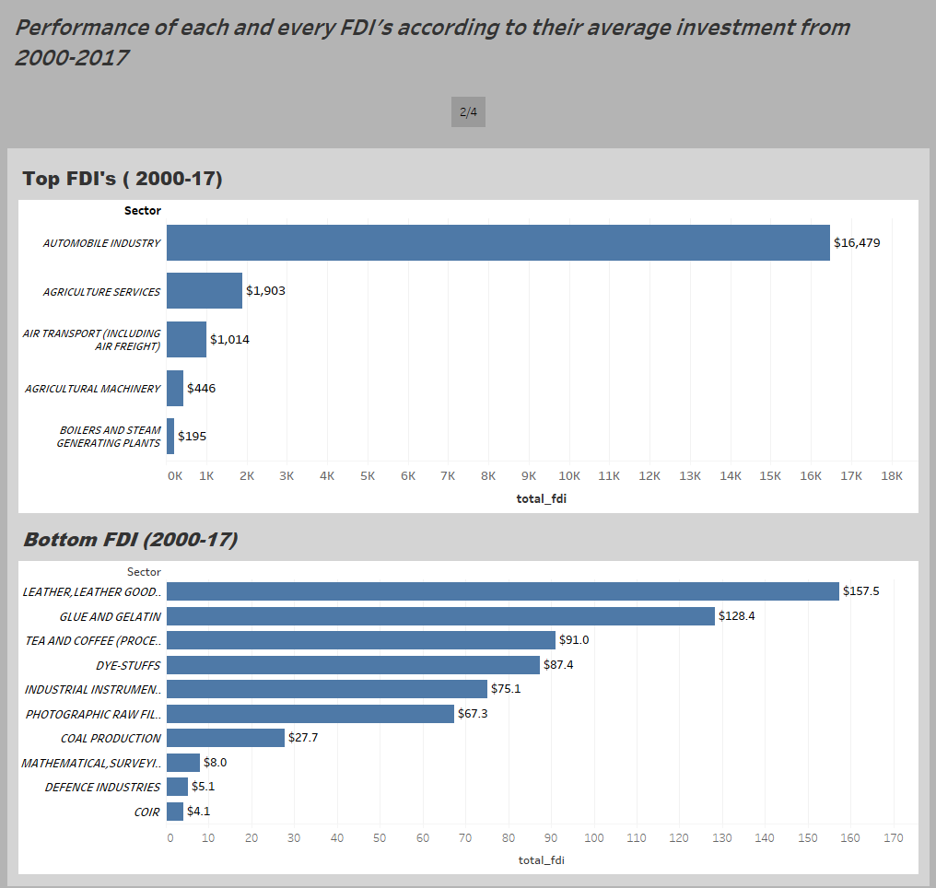

Slide 5
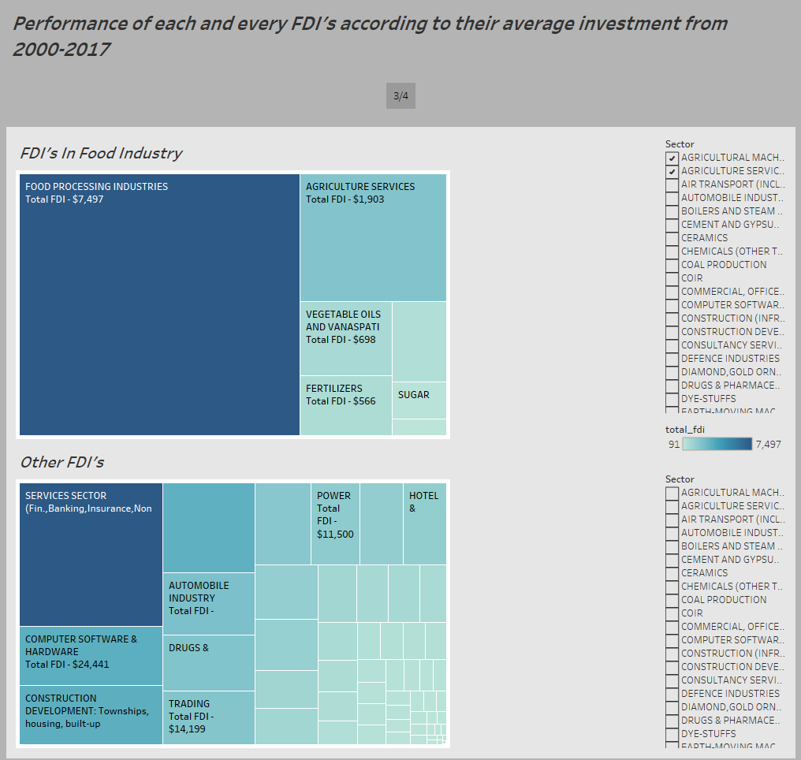

Slide 6
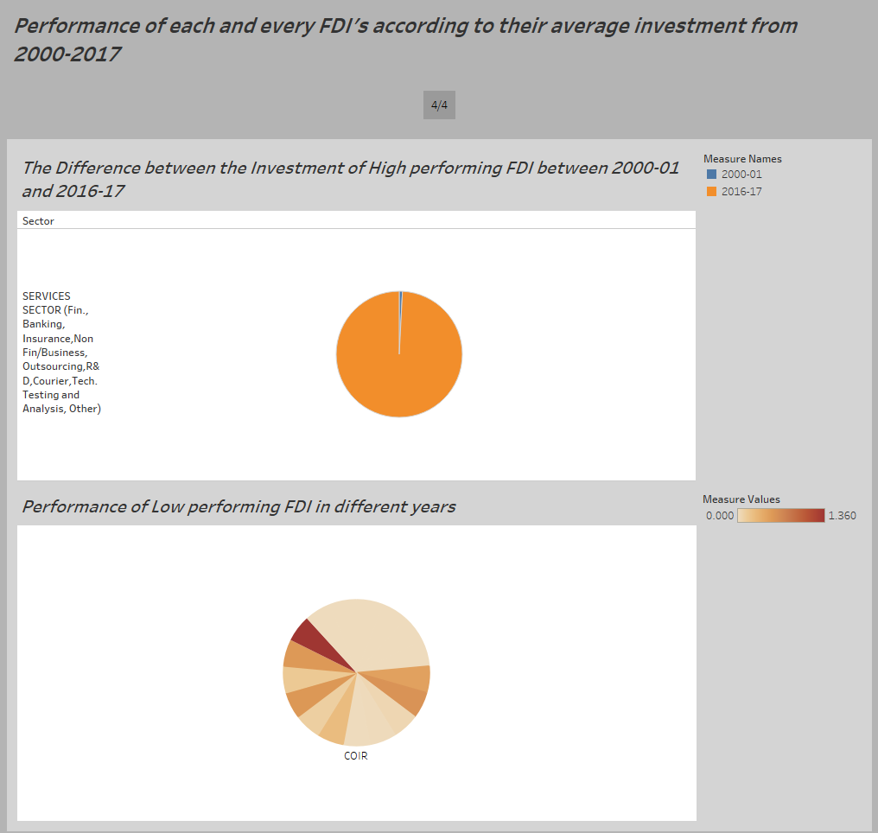

Slide 7
SOME IMPORTANT INSIGHTS FROM THE REPORT
Top average performing foreign direct investment over the years were in service sectors.
The top foreign direct investment from 2000 to 2017 was Automobile industry.
The lowest foreign direct investment from 2000 to 2017 was COIR.
Computer Software market was the second most foreign investment with $24,441 total investment.
The peek year of investment for the lowest performing foreign investment COIR was the year of 2014-16.

Slide 8
THANK YOU

